Slide 1


Electronics and Communications Engineering (ECE)
AGRICULTURAL AID FOR TOMATO HARVESTING
Presented By:
K. Pavan Kartheek 18K91A04A2
J. Manichandra 18K91A0478
G. Rohith Reddy 18K91A0464
Under the Guidance of:
Dr. M. Girish Kumar
(Associate Professor)

Slide 2
Content
Equipment
System Architecture
Libraries
Flow Diagram
Robot Body
Robotic Arm
Training Algorithm
Complications
Output
Limitations
Pros & Cons

Slide 3
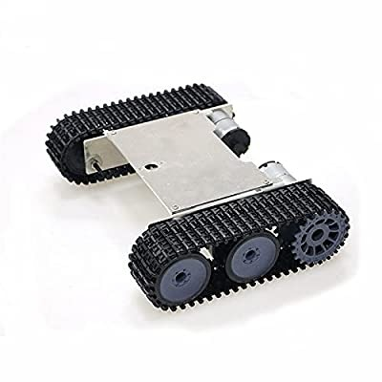
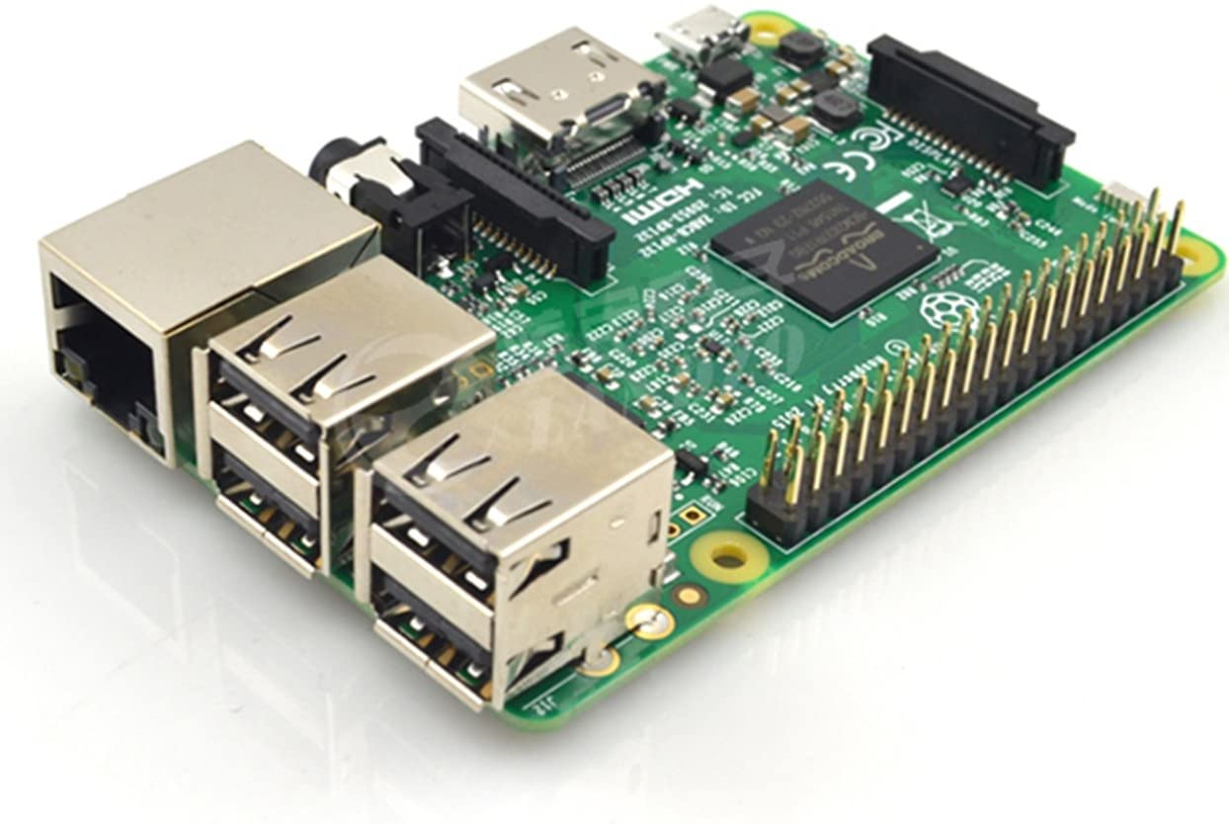
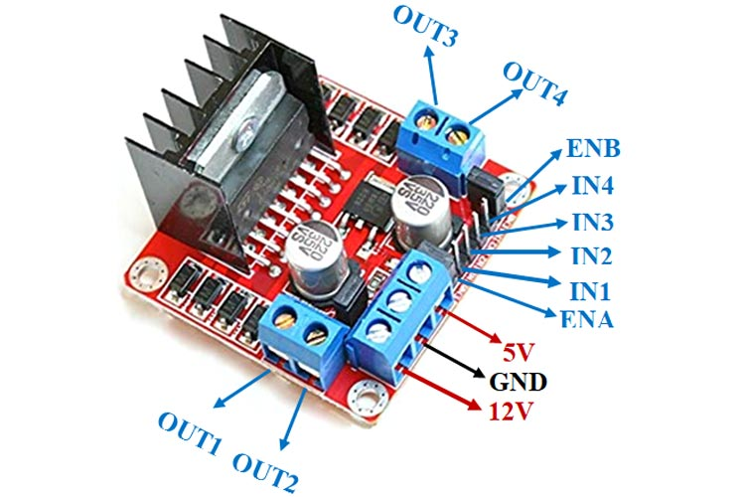
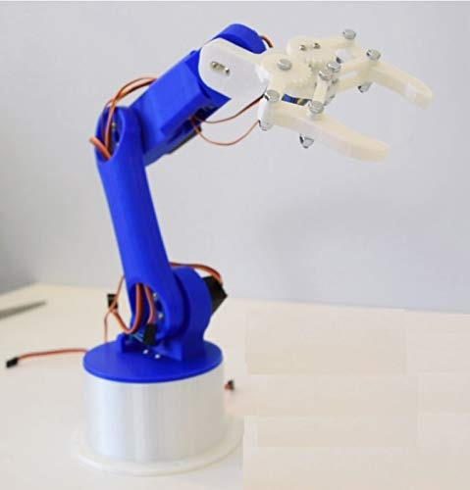
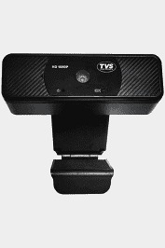
Equipment
Raspberry Pi
Tvs Camera (HD1080P)
Movement Robot with L298N
5DOF Robotic Arm

Slide 4
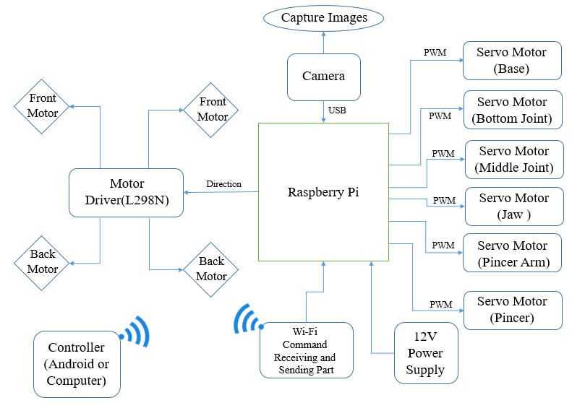
System Architecture

Slide 5






Libraries
Flask
Time
GPIO
Tensorflow
PIL
CV2
Numpy
Filetype

Slide 6
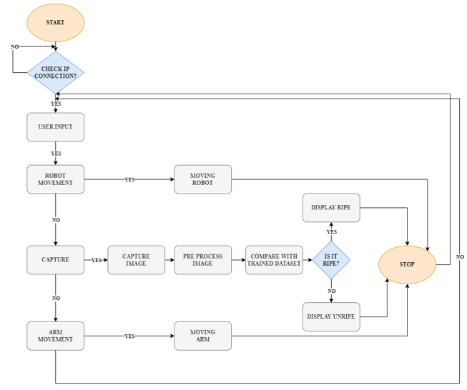
Flow Diagram

Slide 7
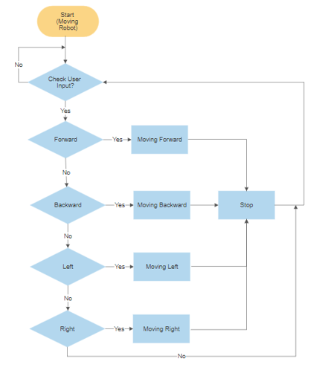
Robot Body Flow Diagram

Slide 8
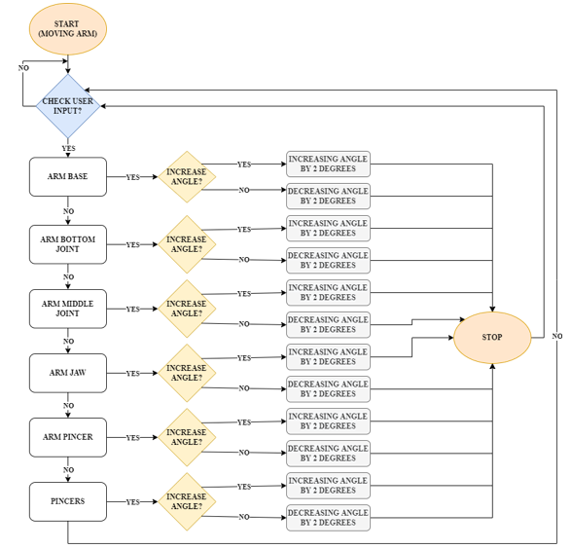
Robotic Arm

Slide 9
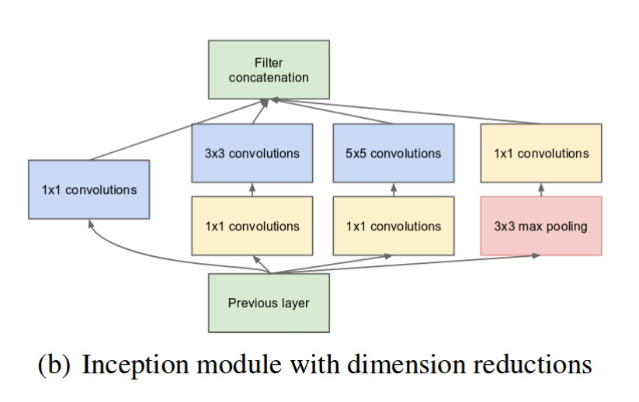

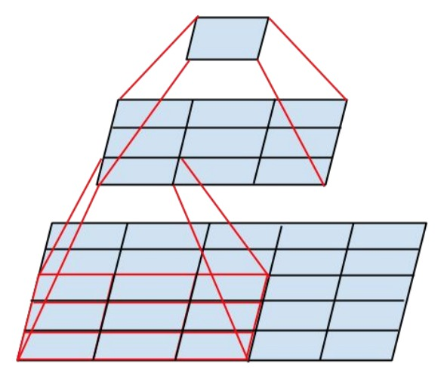
Training Algorithm
Inception V3
The model itself is made up of symmetric and asymmetric building blocks, including convolutions, average pooling, max pooling, concatenations, dropouts, and fully connected layers.
Exponential moving average

Slide 10
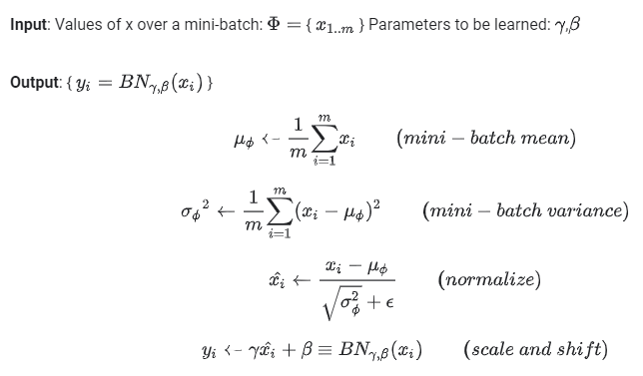
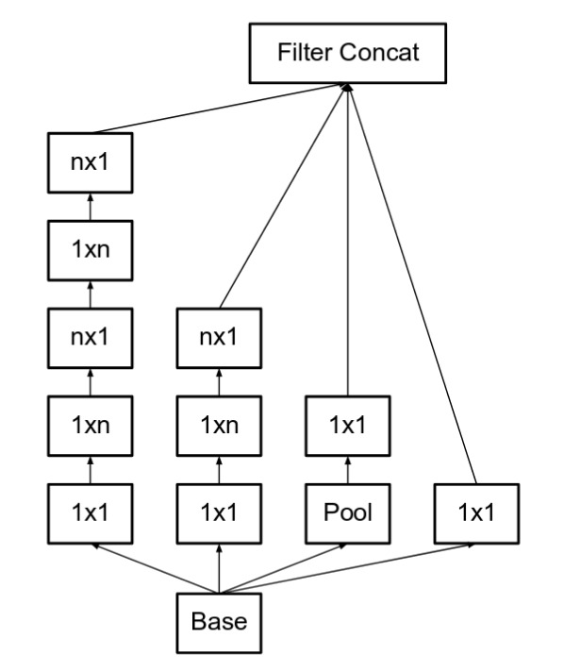

Slide 11
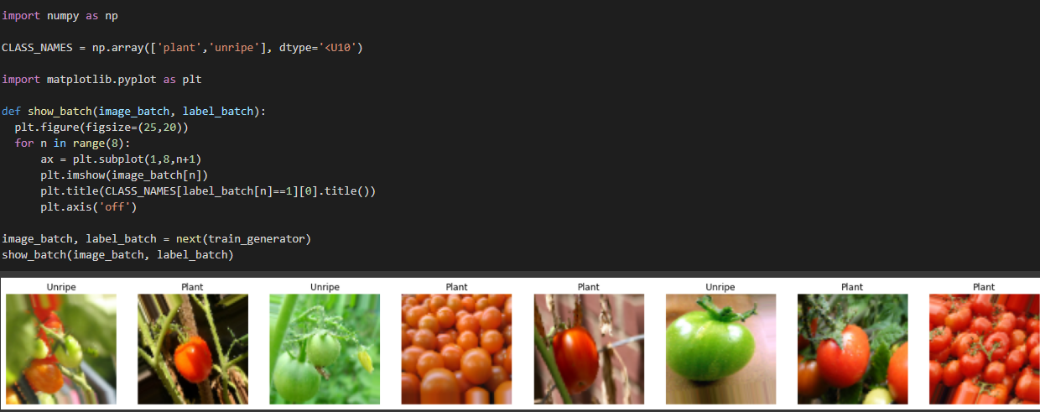

Slide 12
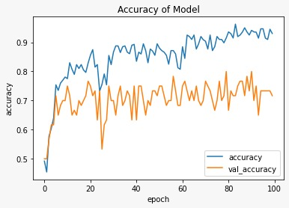
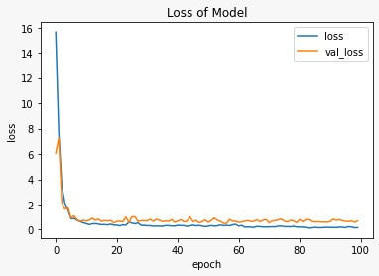

Slide 13
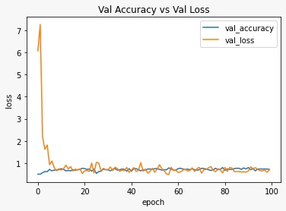

Slide 14
Complications
Dataset
RAM
Storage
Speed
Stability
?

Slide 15
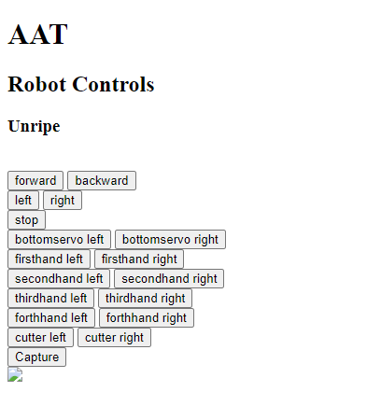
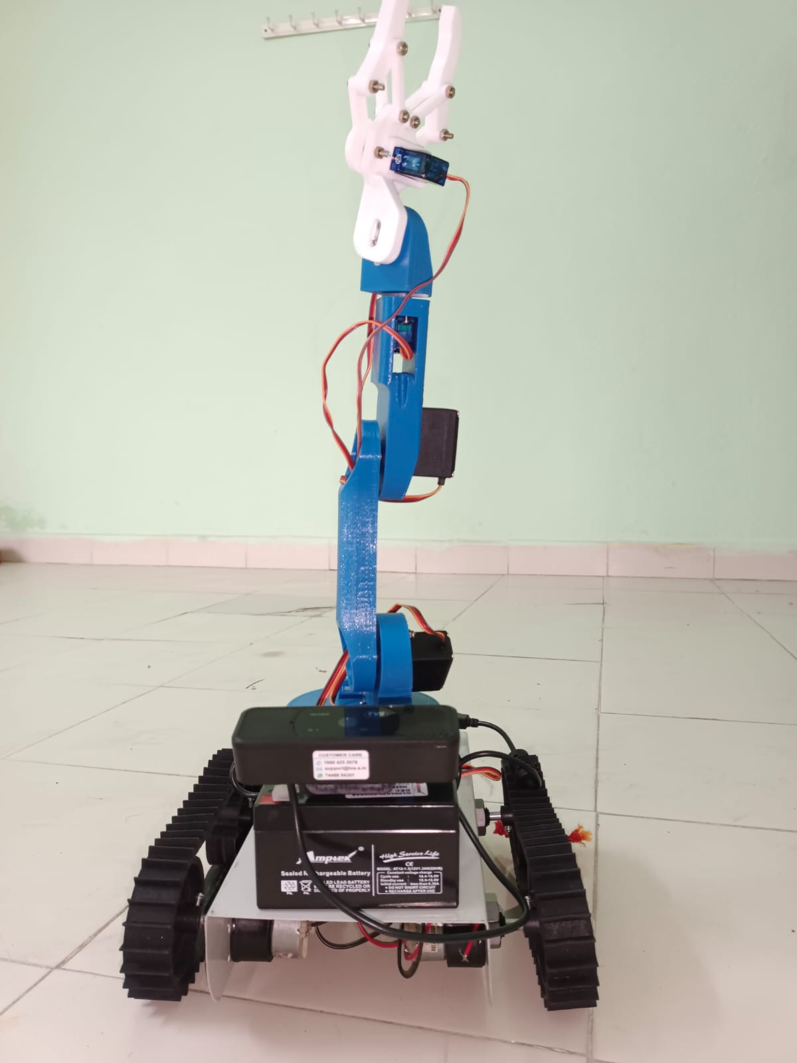
Output

Slide 16
Limitations
Range
Delay
Shape of Tomato
Equipment Arrangement

Slide 17
Pros
Low Cost
Ease of access
Efficient Harvesting
Durable
Easily Replaceable
Cons
Only in Tomato Field
Range or Coverage
Network
Waiting Time is high

Slide 18
Any Queries?

Slide 19
Thank You

